Slide 1


Forecasting Next-Year GDP Growth
Across the EU-27
A Comparative Machine Learning Study
Predicting next-year GDP growth across the EU-27 using World Bank macroeconomic indicators
Ana Preto
Sevgi Özdemir

Slide 2





Research Question and Business Relevance
RESEARCH QUESTION
REAL-WORLD VALUE
Can machine learning reliably predict
next-year GDP growth across the EU-27
using World Bank macroeconomic
indicators?
Next-year growth forecasts inform
fiscal planning, investment decisions,
and institutional risk management.
STUDY OBJECTIVE
FORECASTING CHALLENGE
Compare machine-learning models
with simple baselines and assess
whether additional complexity
improves out-of-sample forecasting
accuracy.
Structural changes, business-cycle
shifts, measurement revisions, and
unexpected shocks can break
historical patterns.

Slide 3















Data Source and Target Design
Dataset overview
Target construction
• Source: World Bank World Development Indicators
• Scope: 27 EU countries
Year t features
macroeconomic indicators
Year t+1 target
next-year GDP growth
• Source period: 1995–2025
• After preprocessing: 810 country-year observations
Features from year t predict GDP growth in the following
year within each country.
• Feature set: 11 macroeconomic indicators
Unit of analysis: country-year.
11 model features
Current GDP growth
GDP per capita
Inflation
Gross fixed capital formation
Unemployment
Trade openness
FDI inflows
Government consumption
Population growth
GDP growth lag 1
GDP growth lag 2

Slide 4
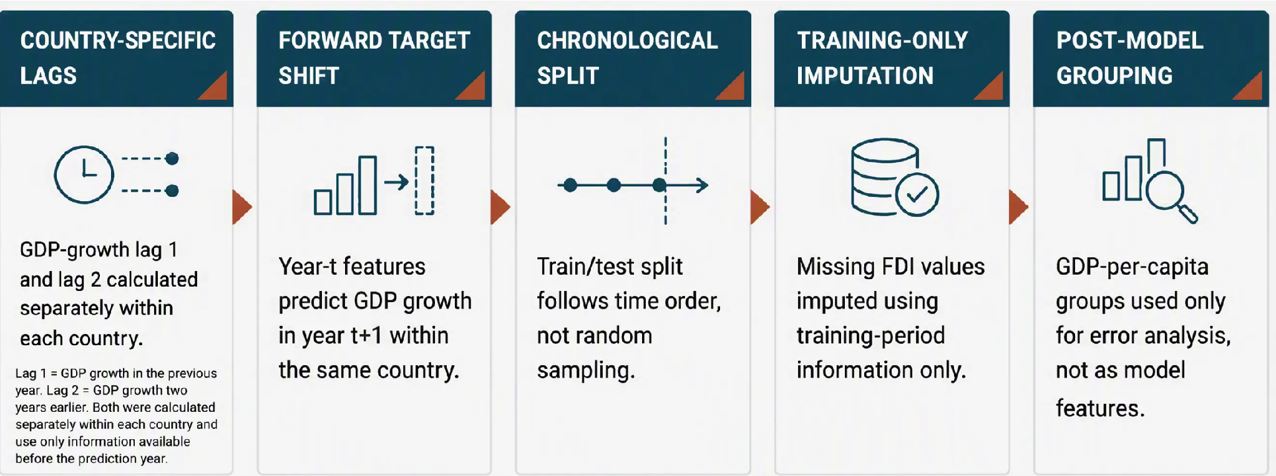

Feature Engineering and Leakage Prevention
Leakage control: These choices keep future test-period information out of model training and make the out-of-sample estimate more credible.

Slide 5


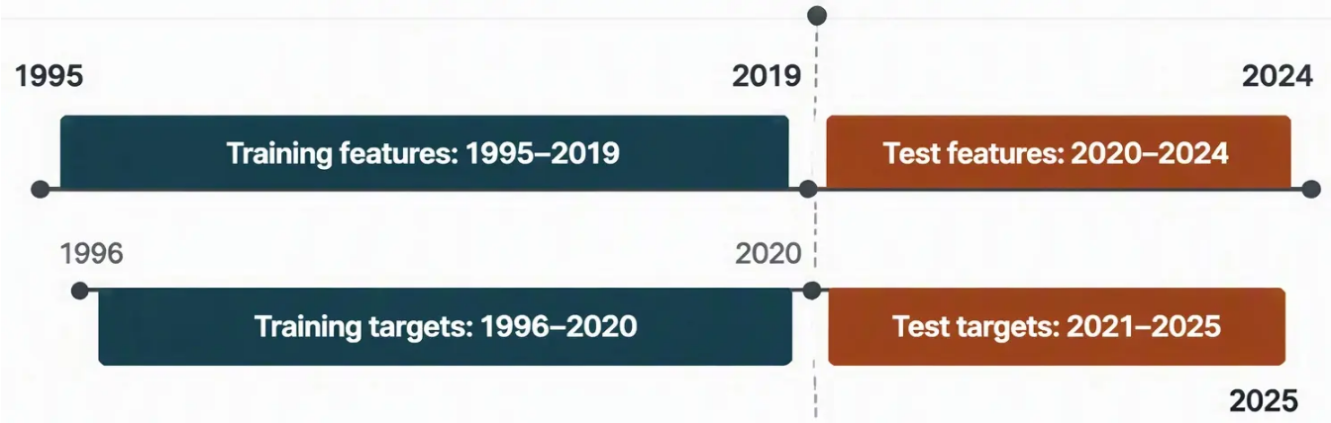
















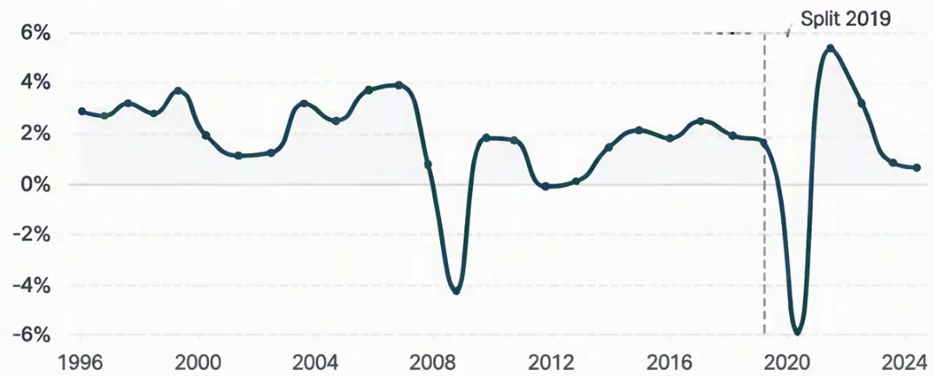







Chronological Evaluation Design
Models are trained on historical country-year data, tuned only inside the training period, and evaluated once on the held-out test period.
Chronological split
Evaluation windows
Stage
Feature years
Target years
1 Training
1995–2019
1996–2020
2020–2024
2021–2025
2 Held-out test
GDP GROWTH OVER TIME — EU-27 AVG — EU-27 GDP growth -- 0% (baseline)
3 Final reporting
Test set used once
No tuning on test
Five-fold
TimeSeriesSplit
was used inside
the training data
for XGBoost
tuning.
Training
observations:
675
Test
observations:
135

Slide 6






Models and Evaluation Metrics
Naive Baselines
Primary Metric: MAE
Naive mean
Mean Absolute Error
Naive persistence
Measured in GDP-growth percentage points
Lower is better
Linear Benchmark
Linear Regression
MAE is the main comparison metric
because it reads directly as the
average absolute forecasting error.
Tree-Based Models
Random Forest
Baseline XGBoost
Secondary metrics: RMSE and R².
Tuned XGBoost
All test R² values remained negative.

Slide 7



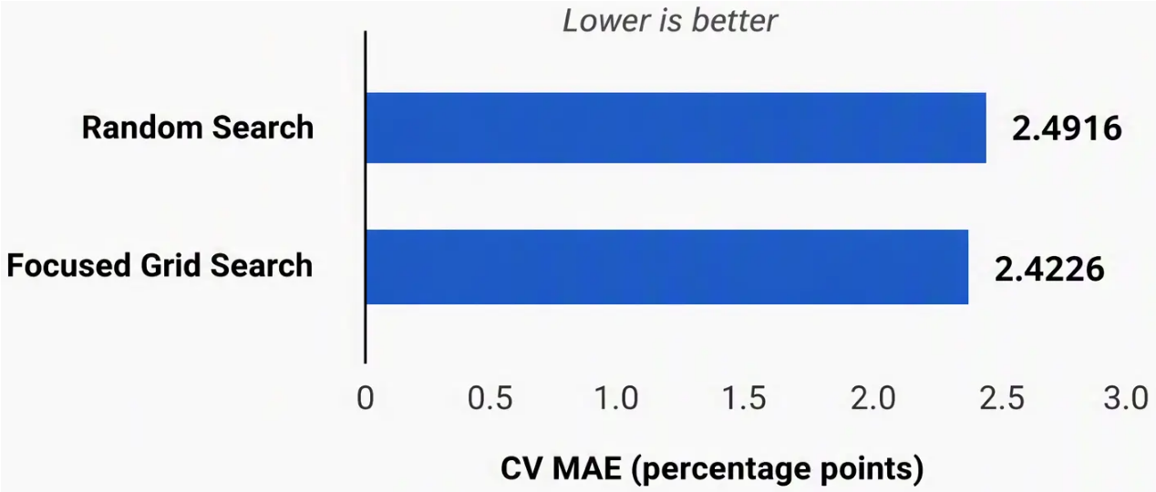



XGBoost Hyperparameter Tuning
XGBoost CV Search Results
Final Configuration
● max_depth = 6
● n_estimators = 90
● learning_rate = 0.035
● subsample = 0.85
● colsample_bytree = 0.7
Reference only: the Naive Mean achieved a final
held-out test MAE of 2.490. This is not a Grid Search
CV score and is therefore not plotted in the CV chart.
● reg_lambda = 1.0
Tuning improved XGBoost internally, but it did not beat the Naive Mean on the final held-out test set.

Slide 8

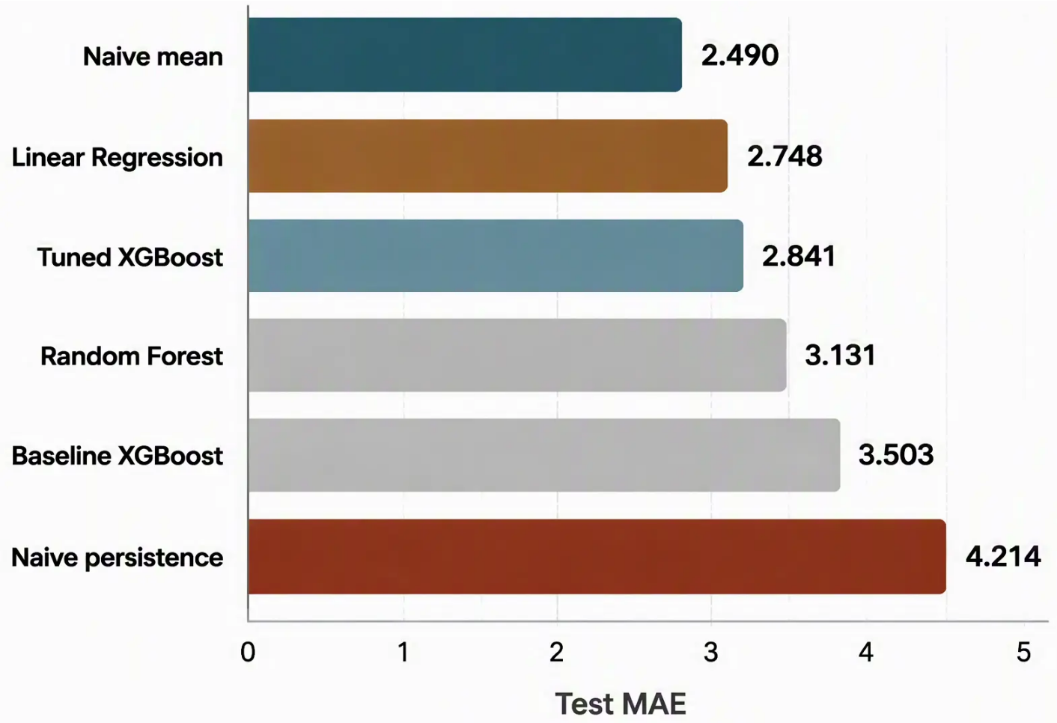



Final Model Performance Results
Test MAE in GDP-growth percentage points — lower is better.
Best overall: Naive mean
Lowest held-out Test MAE: 2.490
Best non-naive: Linear Regression
Test MAE: 2.748
Strongest tree-based: Tuned XGBoost
Improved over baseline XGBoost,
but did not beat Naive mean
All test R² values remained negative,
reinforcing that short-horizon GDP growth
was difficult to predict reliably.

Slide 9

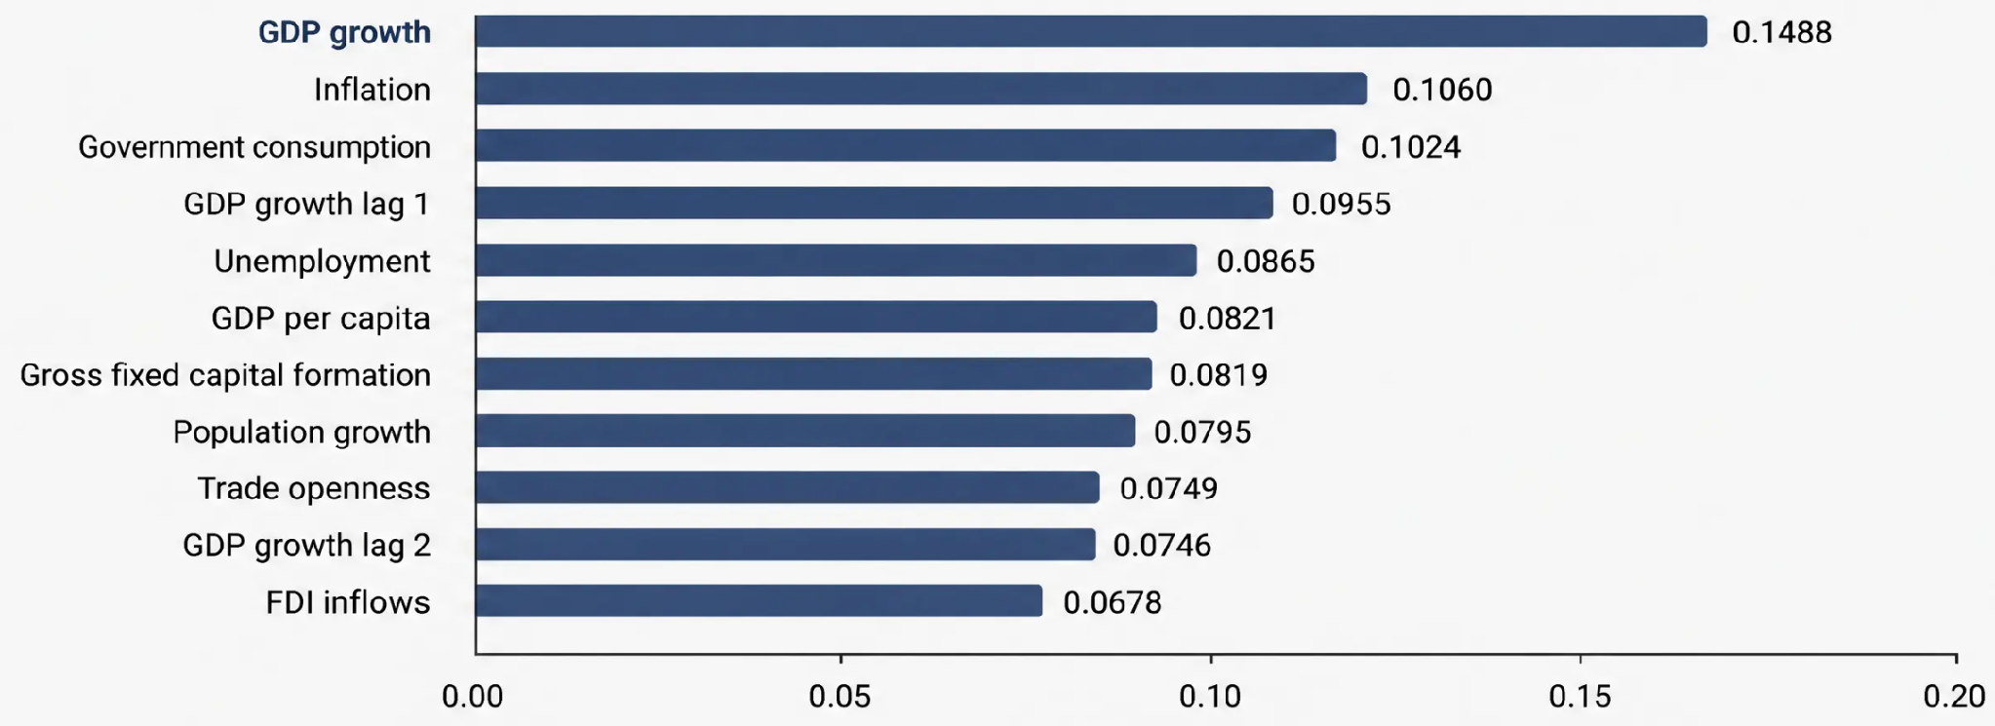
Feature Importance Is Diffuse
Normalized feature importance
GDP growth is the most influential individual feature, followed by inflation, government consumption, and the first GDP-growth lag. However, importance is distributed across all indicators rather than concentrated in one feature.
Feature importance indicates predictive usefulness in this model. It does not demonstrate causality.

Slide 10



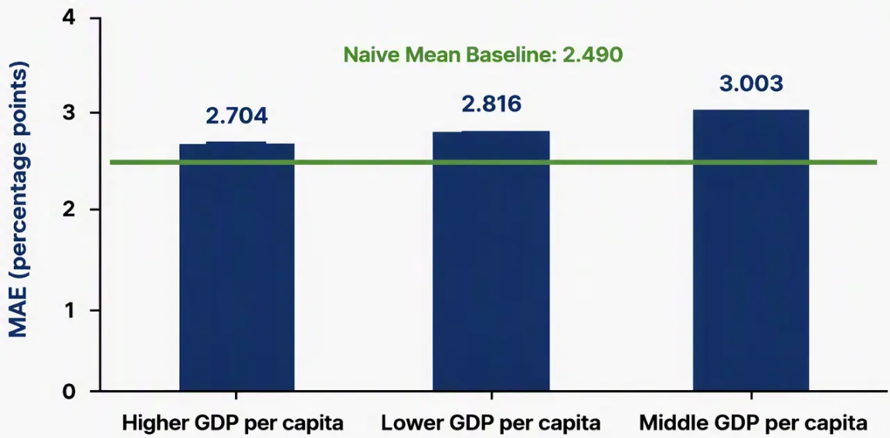
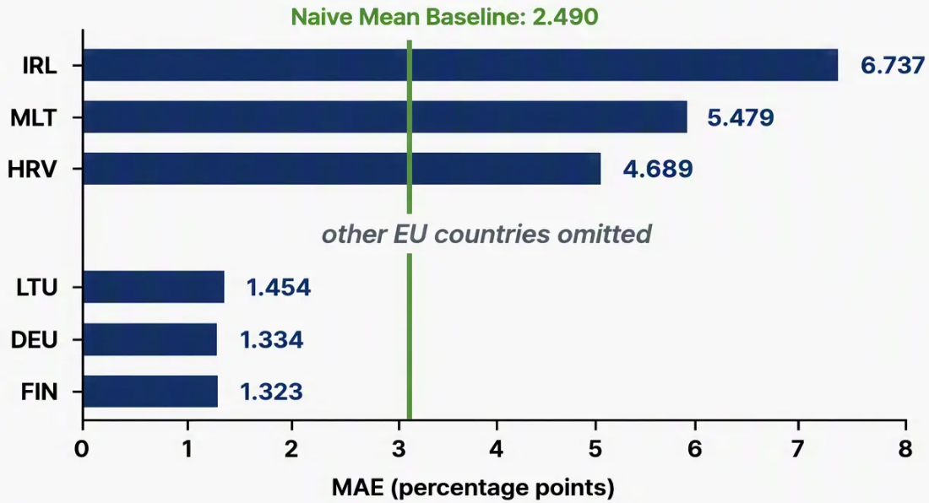




Country and GDP-per-Capita Group Errors
Country-level forecasting errors vary far more than income-group averages.
GDP-per-Capita Group MAE
Country Extremes
Differences are small and non-monotonic.
Country-level spread is much larger than group-level spread.
Main diagnostic
Income groups
Likely influences
Country-level differences
dominate the error pattern.
Group averages remain close,
with no monotonic pattern.
Country-specific shocks, GDP revisions, and accounting
effects matter.
Key Takeaway: Error differences are more country-specific than income-tier-specific.

Slide 11
Interactive Tableau Dashboard

Slide 12







Conclusions, Limitations & Future Work
Conclusions
Limitations
Future work
• Naive mean was best overall — test MAE 2.490.
• Test period includes COVID-19 shocks
and post-pandemic rebounds.
• Use rolling-origin evaluation across
multiple forecast periods.
• Linear Regression was best non-naive — test MAE 2.748.
• Training sample: 675 observations.
• Introduce a separate validation period
for feature selection.
• All test R² values were negative.
• Tuned XGBoost was strongest tree-based — test MAE 2.841.
• Country observations are not fully
independent.
• Add reliable country-specific, shock,
and policy indicators.
• Tuning improved XGBoost but did
not beat the naive mean.
• GDP revisions and country-specific
accounting effects influence results.
• Investigate richer time-series
methods where appropriate.
• Country-level errors exceeded GDP-per-capita group differences.
• Feature importance is predictive,
not causal.
Exploratory feature expansion — not final model performance
Configuration
Test MAE
Test R
Baseline 11 features
2.841
–0.332
Plus current account
2.818
–0.279
Plus current account and lag
2.749
–0.318
Held-out test data were used for this comparison; a separate validation period is required before feature selection.

Slide 13
THANK YOU
Ana Preto
Sevgi Özdemir

